Slide 1
Object Persistence using Hibernate
Hibernate Configuration

Slide 2

Hibernate Configuration
Hibernate using XML
Hibernate using Annotations
Hibernate using Java Configuration
What's in This Module

Slide 3
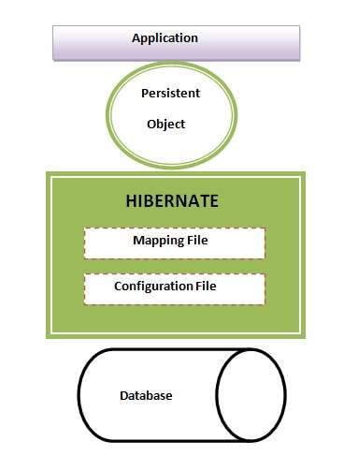
Hibernate Configuration

Slide 4

Assisted Practice
Hibernate using XML

Slide 5
Assisted Practice
Hibernate using Annotations

Slide 6
Assisted Practice
Hibernate using Java Configuration

